Slide 1
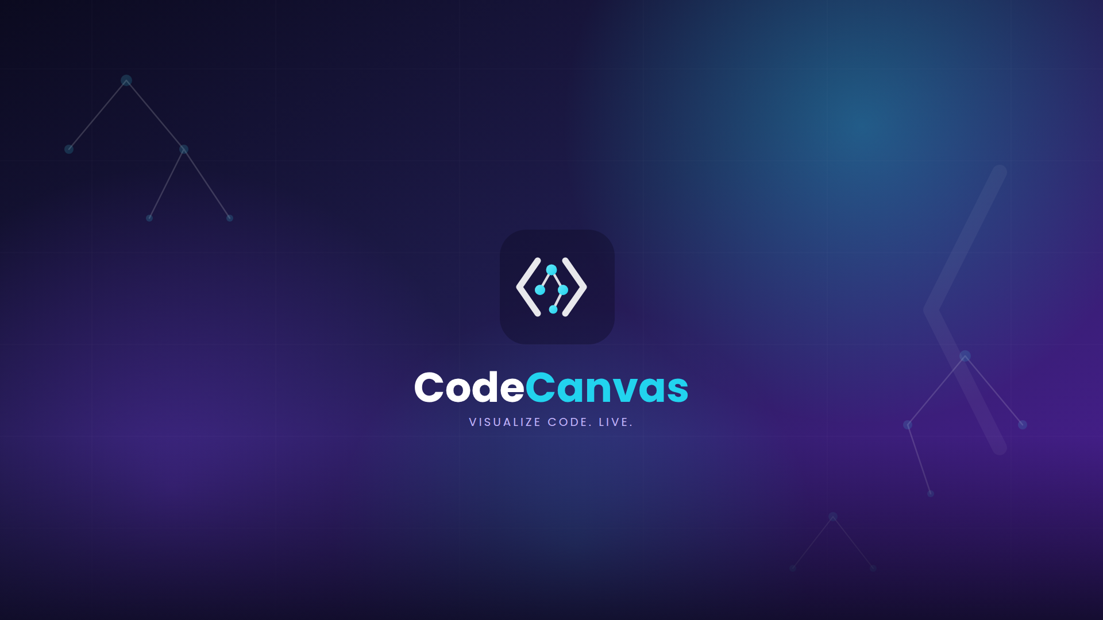

Slide 2
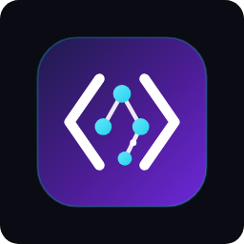
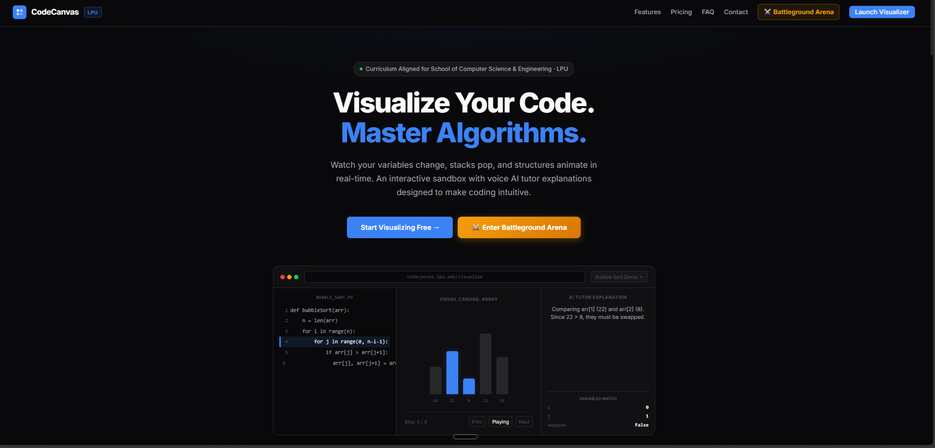
CODECANVAS
Why Do Coding Labs
Feel Like a Nightmare?
CodeCanvas (LPU CodeViz)
Stuck on logic, not syntax
You compile code that looks perfect and still get the wrong output — with zero idea why.
15 students, 1 instructor
Office hours can’t scale to everyone’s segfault at the same moment.
Debugging terminals are a wall
A raw stack trace doesn’t teach a beginner what actually broke.
CODECANVAS
01
Notes:
Hey everyone! Let's be honest for a second. How many of you have sat in a programming lab, written code that you thought was 100% correct, only for it to return a completely wrong output? Or worse, you get a 'Segmentation Fault' or 'Index Out of Range' and have absolutely no idea which line actually broke? You raise your hand, but the lab teacher is already surrounded by 15 other students. You end up wasting half the lab session waiting for help, or coding late at night with zero support. That is the coding lab gap, and today, we're changing that.

Slide 3
THE CORE PROBLEM
Memory Is Invisible
Coding Blind
Standard compilers run your script but keep the memory layout completely hidden.
Static Blackboard Theory
Pointers, stacks, and node links get explained as diagrams — not as motion.
Guesswork Debugging
Without a mental model of memory, every failed run turns into a guess.
YOUR CODE
MEMORY
OUTPUT
arr[j] > arr[j+1]
→
? ? ?
→
wrong
CODECANVAS
02
Notes:
The reason programming feels so intimidating when you start is that computer memory is invisible. When a professor explains pointers referencing memory, nodes swapping in a linked list, or stacks popping in a recursion loop, they write it statically on a blackboard. But when you sit in front of VS Code, you can't see the memory stack. You are essentially coding blind. You compile, it fails, and you guess. What if you could actually see your variables mutating, your arrays sorting, and your linked lists linking, step-by-step in real-time?

Slide 4
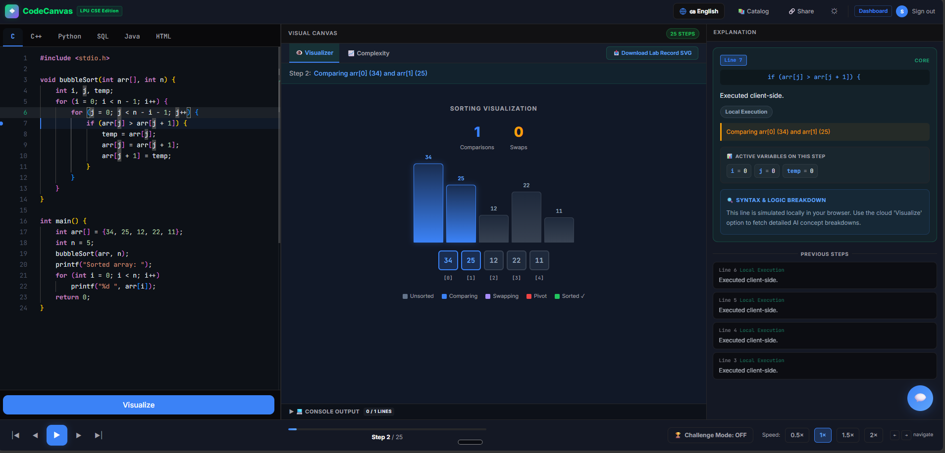
THE SOLUTION
CodeCanvas (LPU CodeViz)
Monaco Coding Editor
Paste and edit real C, C++, Python, Java, or SQL — no setup required.
10 Animated Canvases
Watch arrays sort, stacks pop, and trees balance — one step at a time.
Live Variables Board
Track every variable mutation and scope change in real time.
AI Tutor Companion
Hint-driven guidance that nudges you toward the fix — not the answer.
CODECANVAS
03
Notes:
This is CodeCanvas, also known as LPU CodeViz. It's a web-based coding environment built specifically for us. You write your C, C++, Python, or SQL code in a built-in editor, click 'Visualize', and the system generates a step-by-step animated playback of your program. You can watch your array bars swap during Bubble Sort, watch your recursion call stack grow and shrink, and see variable scopes update instantly.

Slide 5
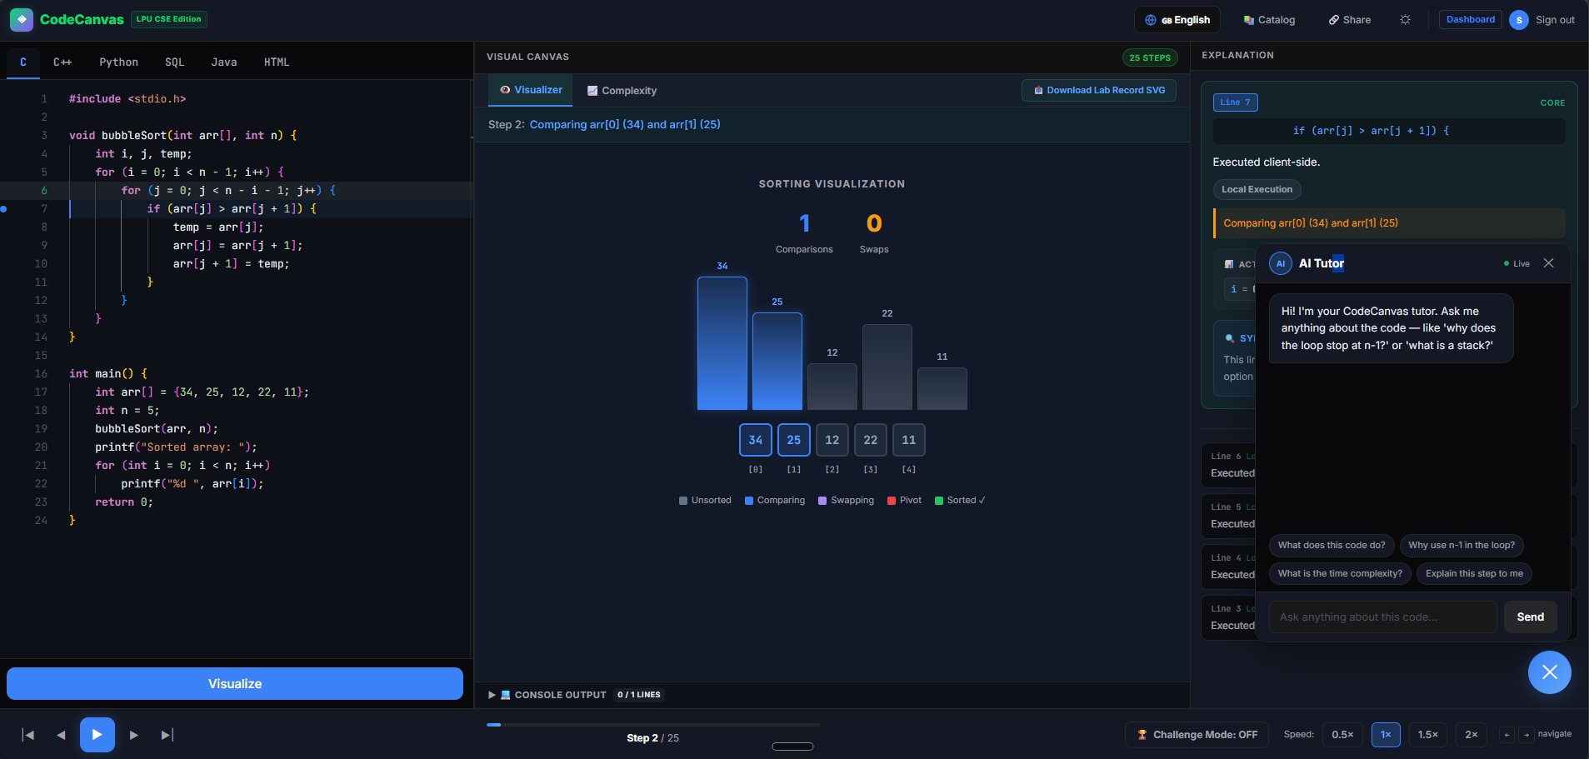
AI TUTOR COMPANION
Never Debug Alone Again
Ask Anything, Anytime
No lab hours required — get real guidance at 2am, the night before a deadline.
Context-Aware Hints
The tutor sees your exact code and the current execution step — not a generic FAQ.
Guides, Doesn’t Solve
Nudges you toward the fix so the understanding actually sticks.
CODECANVAS
04
Notes:
There's a built-in AI Tutor sidebar that acts like a personal teacher, checking your specific code and guiding you to fix bugs without giving away answers. Stuck on a nested loop or a pointer dereference? Just ask it directly, right at the step where you're stuck.

Slide 6
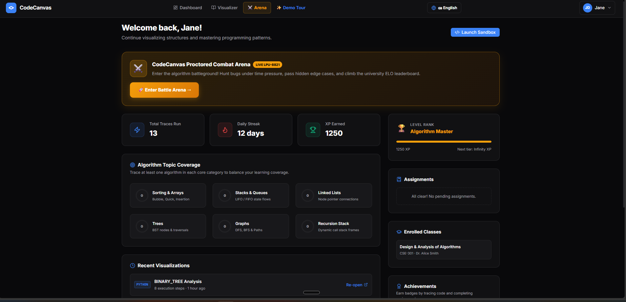
WHAT'S IN IT FOR YOU
Stay Motivated, Stay Consistent
13
TRACES RUN THIS WEEK
12-Day
ACTIVE CODING STREAK
1,250 XP
‘ALGORITHM MASTER’ RANK
Verified, cryptographically-signed certificates — shareable straight to LinkedIn.
Pre-loaded with 20+ examples mapped to CSE101, INT101, CSE205 & INT301.
CODECANVAS
05
Notes:
So how does this help you pass your exams and build real coding skills? First, it gives you an instant mental model of memory, saving you hours of frustration. Second, you can debug your code late at night — it's like having a coding tutor in your browser 24/7. It's gamified: you earn XP, build coding streaks, and once you complete a topic, you get a cryptographically verified certificate shareable on LinkedIn to stand out to recruiters.

Slide 7
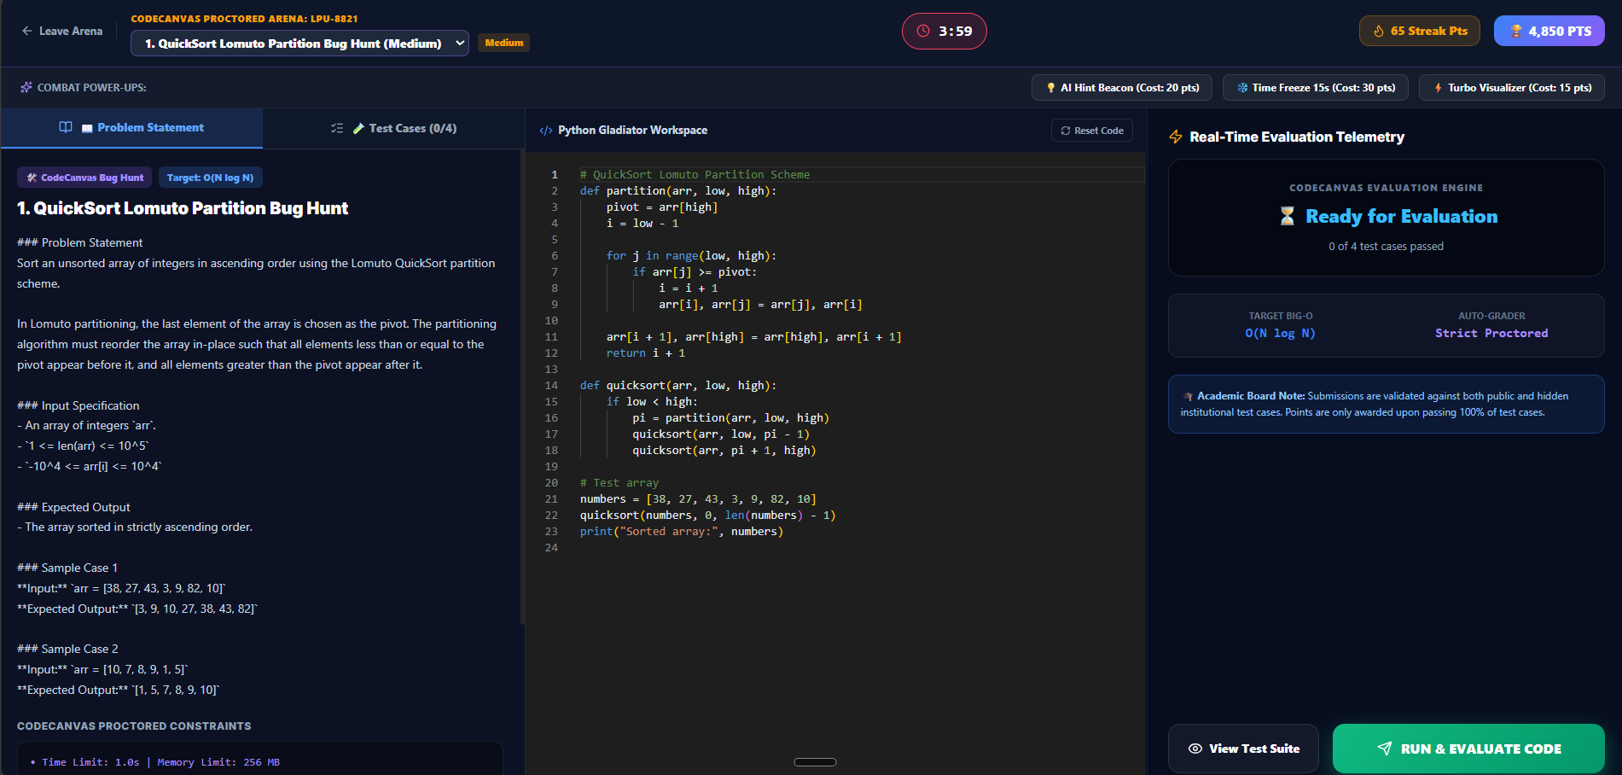
BATTLEGROUND ARENA
Turn Practice Into Competition
Kahoot meets LeetCode — live, on the classroom projector.
Live Classroom Battles
Faculty host 5-minute algorithm duels, projected for the whole room to follow.
Real Bugs, Real Pressure
Fix a broken QuickSort partition or a Big-O trap while the clock is running.
University ELO Ladder
Climb the rankings and earn recruiter-visible, verified badges.
CODECANVAS
06
Notes:
And it's not just solo practice — we've pre-loaded standard syllabus exercises into a competitive mode too. Faculty can host a live 5-minute coding battle projected right on the classroom screen, and you can duel classmates 1v1 to climb the university ELO ladder. It turns a dry algorithm lecture into something closer to an esport.

Slide 8
LET'S GET YOU SET UP
Get Registered in 30 Seconds
01
02
03
04
Visit
Register
Join Classroom
Start Coding
https://lpu-code-viz.vercel.app/
One-click sign-up with Google OAuth or email
Enter invite code: [CLASS_INVITE_CODE]
Visualize your first program — and start your streak
Scan the code on screen right now — or open https://lpu-code-viz.vercel.app/ on your phone.
CODECANVAS
07
Notes:
Signing up is incredibly fast. Pull out your phone right now, scan the QR code on the screen, or open codecanvas.edu in your browser. Click 'Sign Up', log in instantly with your Google account, and select the 'Student' role. To join our lab section and track your outcomes, simply enter the classroom invite code shown here. It takes less than 30 seconds. Register now, start visualizing your code, and let's make coding labs a breeze this semester. Thanks everyone!

Slide 9

https://lpu-code-viz.vercel.app/

Slide 10

https://forms.gle/tT6z6kVE1X7UnduT6

